Slide 1
Design & Development Of Smart Campus ERP System
Mohammad Hafijul Islam
Reg No: 14502000922
Mokhber Uddin
Reg No: 14502000924

Slide 2
Contents
Introduction
Objective
Existing System
Proposed System Features
System Structure
DF Diagram
User Interface
Conclusion & Future Work

Slide 3
Introduction
Smart Campus ERP is multi-user Enterprise Resource Planning system.
It utilizes Institutes human and other resources to minimize administrative and academic task.

Slide 4
Objective
Maintain Institute Information Flow, fast-secure and ease to access.
Minimizing total number of system and Information conflict with common database sharing.
Improve Services for faculty, stuff, student and other stack holder.
Enable higher availability of administrative systems.
Student, Techer & parent communication thought central management and notification of doubt.

Slide 5
Existing System
SAP AG– R/3
Oracle Corporation– Oracle Applications
PeopleSoft Inc.– PeopleSoft8
The Baan Company– BaanERP
J.D. Edwards & Co.– OneWorld

Slide 6
Proposed System Features
Admission Management
Fees Management
Department management
Library Management
Examination Monitoring
Staff Attendance & Payroll
Student Information System
University & Trust board Control
Payment gateway

Slide 7
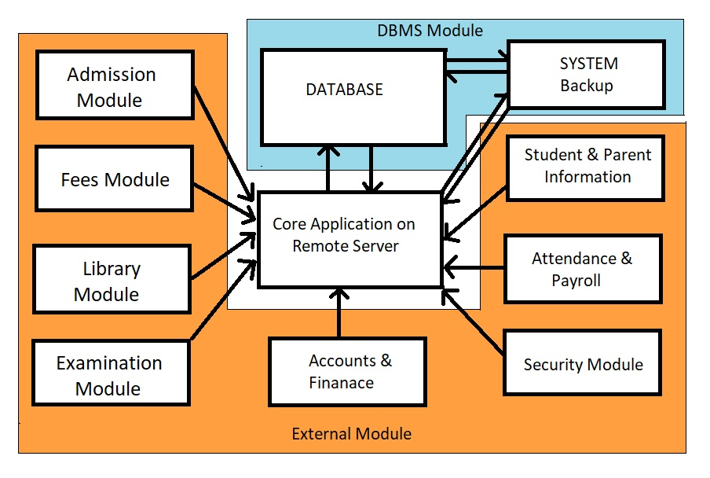
System Structure
System Architecture

Slide 8
DF Diagram
Level O – DFD
Level – 1 DFD

Slide 9
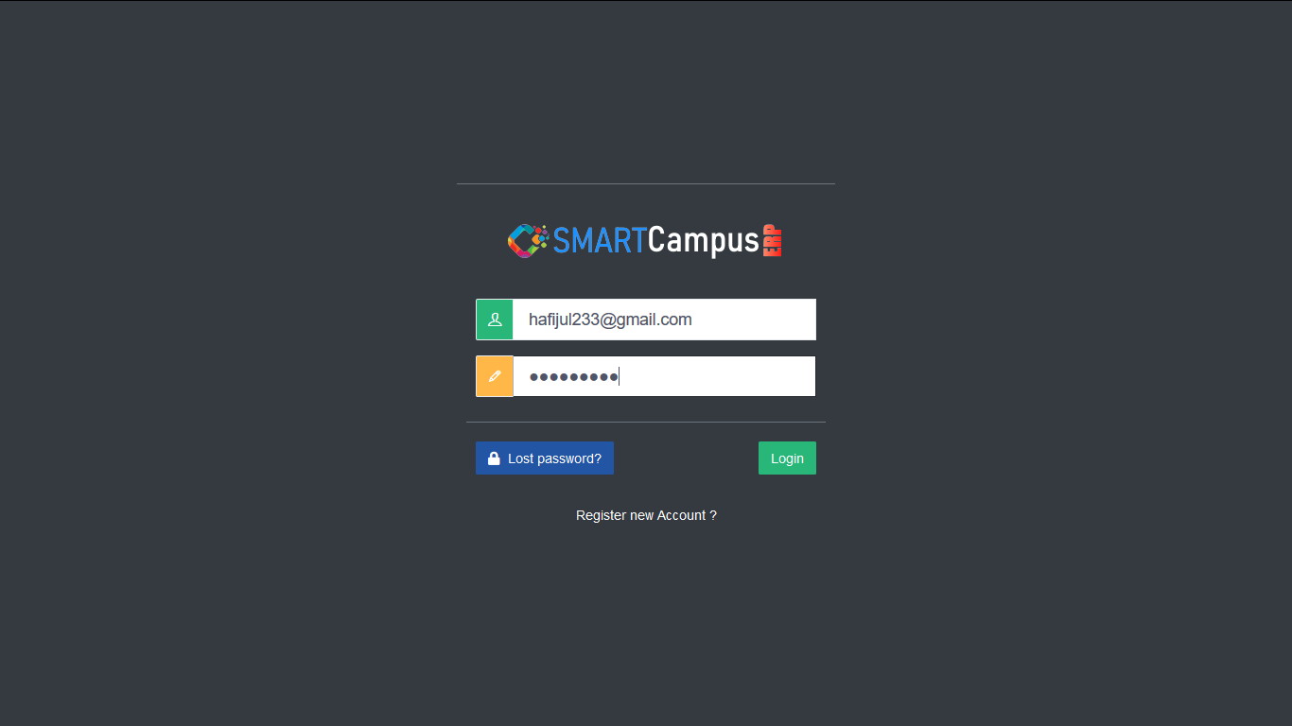
User Interface

Slide 10
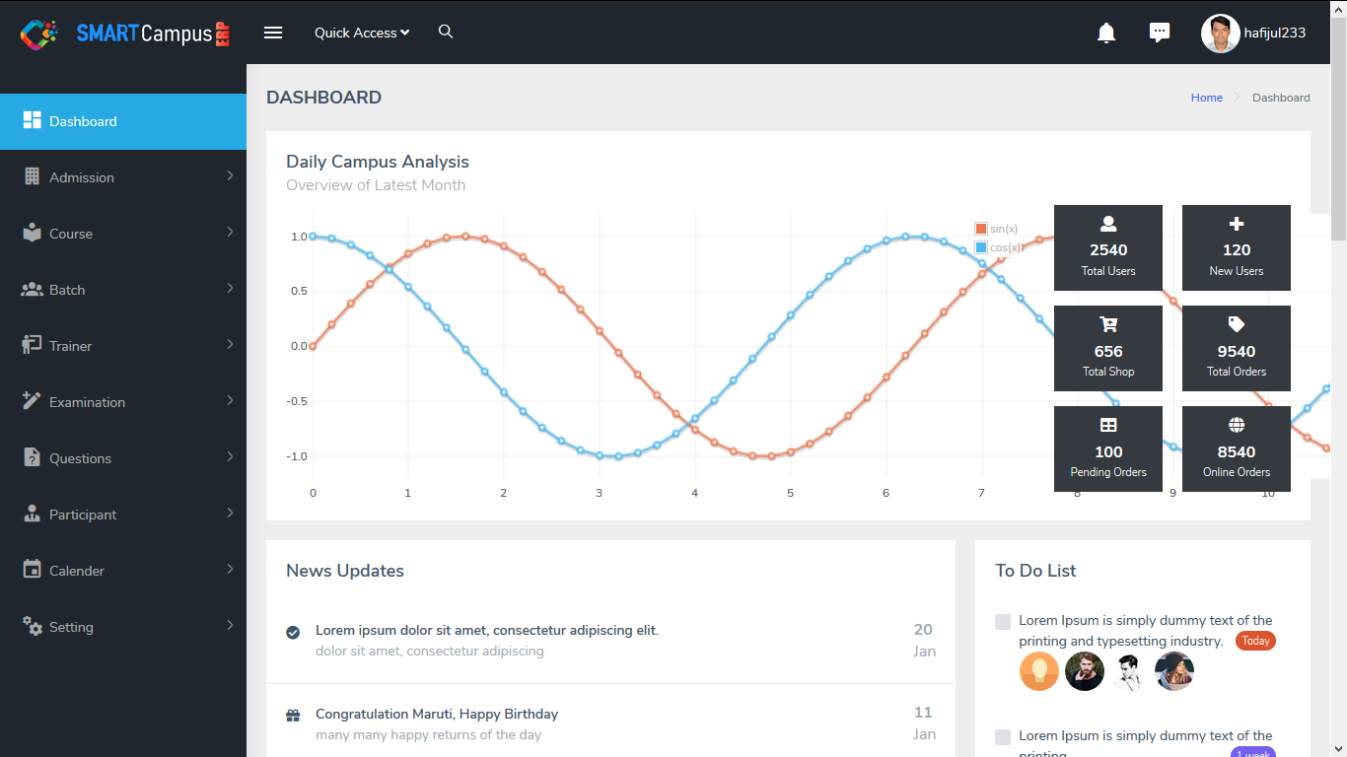
User Interface

Slide 11
Conclusion & Future Work

